Slide 1

CZ2001 – ALGORITHMS – EXAMPLE CLASS 2
Group 3
Tan Wei Xuan
Datta Anusha
Prashant Mohit

Slide 2

INTRODUCTION

Slide 3
PROBLEM DOMAIN

Slide 4

PROBLEM DOMAIN
Many real world problems requires to search a huge amount of data.
examples:
• Storing and Searching of employee information based on NRIC numbers
• Storing and Searching of vehicle information based on car plate registration numbers
• Storing and Searching of person information based on phone numbers
for this example class, we chose:
STORING AND SEARCHING OF BOOKS’ NAME
BASED ON INTERNATIONAL STANDARD BOOK NUMBER
INTRODUCTION • IMPLEMENTATION • STATISTICS • CONCLUSION

Slide 5
DATA SETS

Slide 6
DATA SETS
Since real world data sets are not available, synthetic data sets are generated
Amount of Data Generated will be based on Load Factor (User Input)
INTRODUCTION • IMPLEMENTATION • STATISTICS • CONCLUSION

Slide 7
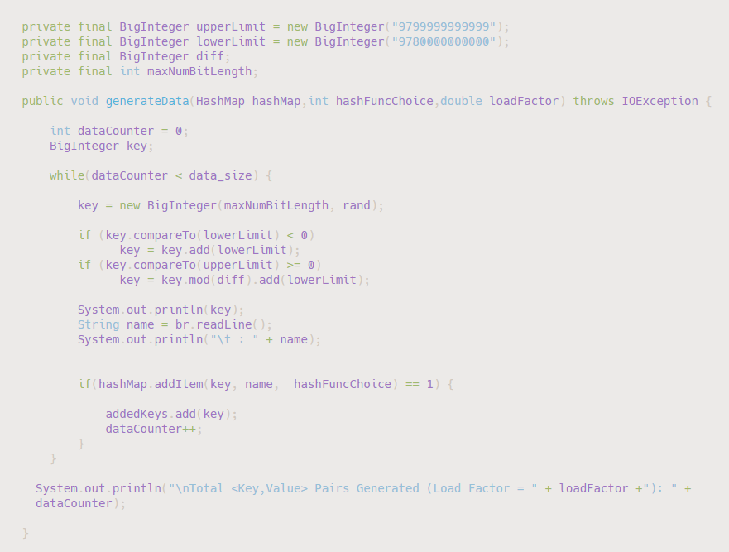
//Range of Data
//Method to generate Random Number
//Add item to Hash Table

Slide 8
IMPLEMENTATION

Slide 9
IMPLEMENTATION
LINEAR PROBING
HASHING FUNCTIONS
Division
Mid-Square
Shift Folding
INTRODUCTION • IMPLEMENTATION • STATISTICS • CONCLUSION

Slide 10
LINEAR PROBING

Slide 11
LINEAR PROBING
Linear probing is simplest to resolve hash collisions
how it is done:
It is done by searching the hash table for a free location sequentially
algorithm:
newHashIndex = (oldHashIndex + 1) % HASHTABLE_SIZE
INTRODUCTION • IMPLEMENTATION • STATISTICS • CONCLUSION

Slide 12
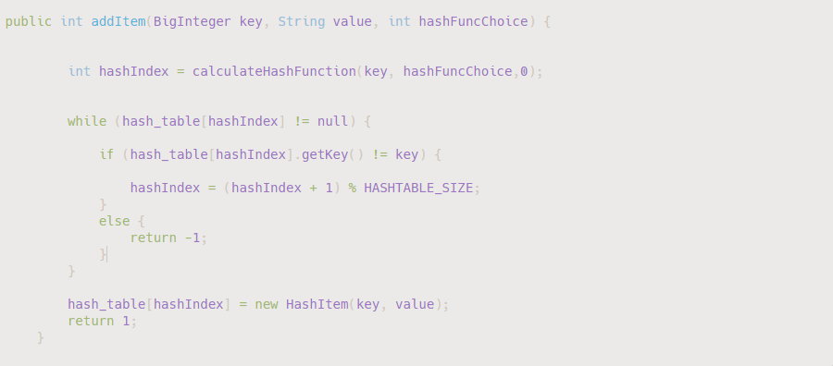
//Hash Function
//If Slot is not empty
//If key is not the same
//Rehash by moving to next slot
//Insert <key,value> pair into slot

Slide 13
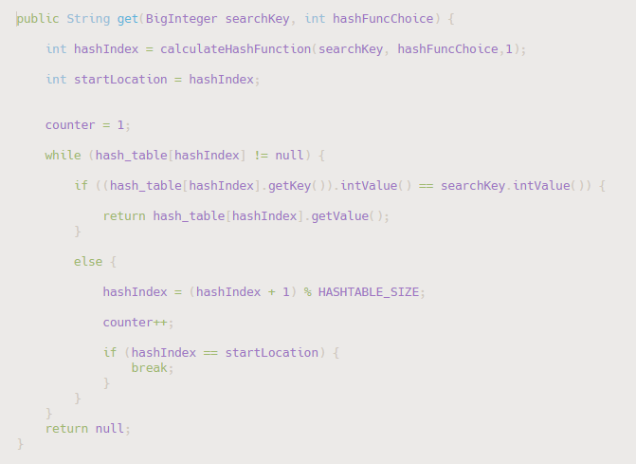
LINEAR PROBING
//Start Location of Search
//Slot is not empty
//Key in slot = Search Key
//Rehash by moving to next slot
//Comparison Counter
//Hash Index back to start point
INTRODUCTION • IMPLEMENTATION • STATISTICS • CONCLUSION

Slide 14
HASHING FUNCTIONS

Slide 15
DIVISION METHOD

Slide 16
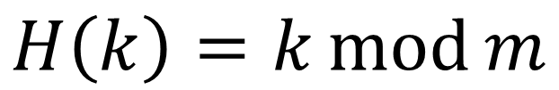
DIVISION METHOD
how it is done:
Divides an integer key by the hash table size and remainder taken as hash value
algorithm:
$$H\left(k\right)=k\operatorname{mod}{m}$$
where:
$$m is some predetermined divisor integer \left(i.e., the table size\right),$$ $k is the preconditioned key and$
$$mod stands for modulo$$
INTRODUCTION • IMPLEMENTATION • STATISTICS • CONCLUSION

Slide 17
DIVISION METHOD
We divide our Search Key (ISBN) by the Hash Table Size and the remainder will be the Hash Value
INTRODUCTION • IMPLEMENTATION • STATISTICS • CONCLUSION

Slide 18
SHIFT FOLDING

Slide 19
SHIFT FOLDING
how it is done:
Breaks a key into precise segments, with the exclusion of the last segment. Segments added together. Division method applied to obtain hash value
algorithm:
$$H\left(k\right)=(a+b+ …+n)\operatorname{mod}{m}$$
where:
$$a,b…n represents the preconditioned key broken down into n parts$$ m$is the hash table size$
$mod stands for modulo$
INTRODUCTION • IMPLEMENTATION • STATISTICS • CONCLUSION

Slide 20
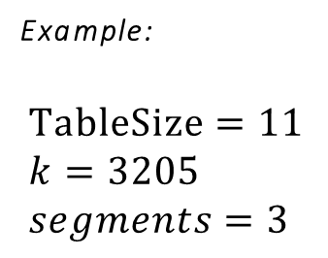
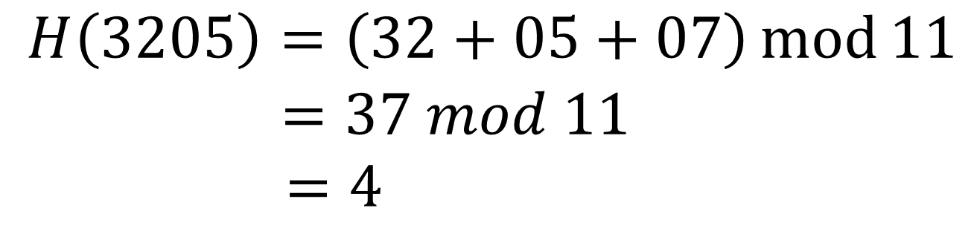
SHIFT FOLDING
Example:
$$TableSize=11 \\ k=3205 \\ segments=3$$
$$H\left(3205\right)=\left(32+05+07\right)\operatorname{mod}{11}$$ $=37 mod 11$ $$=4$$
INTRODUCTION • IMPLEMENTATION • STATISTICS • CONCLUSION

Slide 21
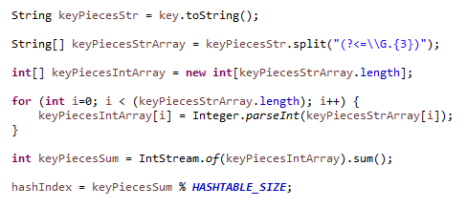
SHIFT FOLDING
We first split up the key into 5 segments
INTRODUCTION • IMPLEMENTATION • STATISTICS • CONCLUSION

Slide 22
SHIFT FOLDING
9794524858761
979 | 452 | 485 | 876 | 91
We will have 4 equal segments comprising of 3 elements and
1 segment comprising of 1 element
INTRODUCTION • IMPLEMENTATION • STATISTICS • CONCLUSION

Slide 23
SHIFT FOLDING
Apply Division Method
Sum up the Segments
INTRODUCTION • IMPLEMENTATION • STATISTICS • CONCLUSION

Slide 24
MID-SQUARE METHOD

Slide 25
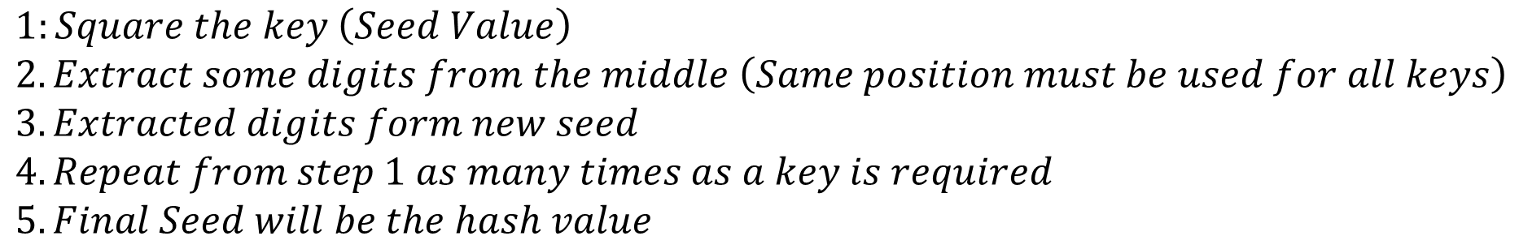
MID-SQUARE METHOD
how it is done:
Squares the key value, and then takes out the middle r bits. Repeat process as needed
algorithm:
$$1:Square the key \left(Seed Value\right) \\ 2. Extract some digits from the middle \left(Same position must be used for all keys\right) \\ 3. Extracted digits form new seed \\ 4. Repeat from step 1 as many times as a key is required \\ 5. Final Seed will be the hash value$$
INTRODUCTION • IMPLEMENTATION • STATISTICS • CONCLUSION

Slide 26
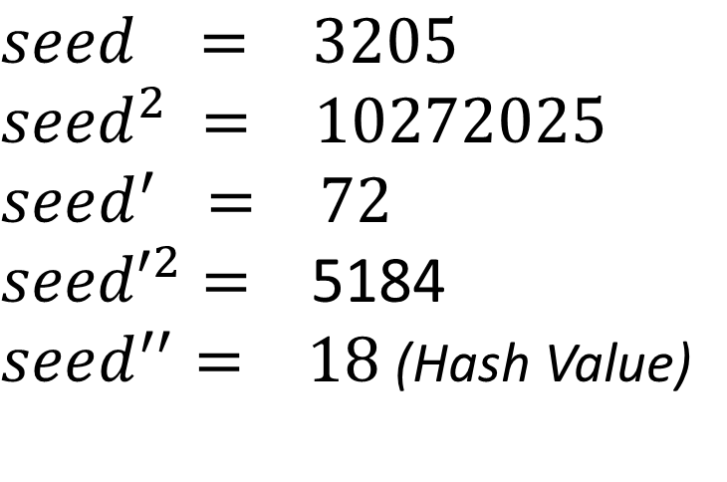
MID-SQUARE METHOD
how it is done:
Squares the key value, and then takes out the middle r bits. Repeat process as needed
Example:
$$seed = 3205 \\ {seed}^{2} = 10272025 \\ seed^{′} = 72$$ ${seed′}^{2}=$ 5184
$seed^{′′}= 18$ (Hash Value)
INTRODUCTION • IMPLEMENTATION • STATISTICS • CONCLUSION

Slide 27
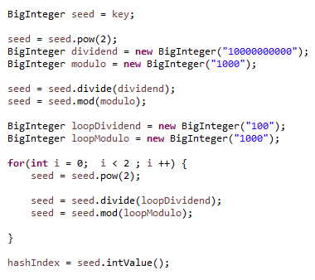
SHIFT FOLDING
Ensure same position is used for all keys
Repeat as needed
Extract new Seed
Square the Seed
Final seed is hash value
INTRODUCTION • IMPLEMENTATION • STATISTICS • CONCLUSION

Slide 28
STATISTICS

Slide 29
STATISTICS
DIVISION METHOD
Load Factor | Data Size | Successful |  | Unsuccessful
 |  | Average Number of Comparisons | Average CPU time (nanoseconds) | Average Number of Comparisons | Average CPU time (nanoseconds)
0.1 | 100 | 1 | 8621.3 | 1 | 1111.4
0.3 | 302 | 1 | 4014 | 1 | 1083.7
0.5 | 504 | 1 | 648.8 | 2.1 | 867.5
0.7 | 706 | 1.8 | 711.4 | 4.9 | 1451.9
0.9 | 908 | 5 | 665.8 | 44.8 | 2630.3
INTRODUCTION • IMPLEMENTATION • STATISTICS • CONCLUSION

Slide 30
STATISTICS
SHIFT FOLDING
Load Factor | Data Size | Successful |  | Unsuccessful
 |  | Average Number of Comparisons | Average CPU time (nanoseconds) | Average Number of Comparisons | Average CPU time (nanoseconds)
0.1 | 100 | 1 | 32288.6 | 1 | 27967.6
0.3 | 302 | 1 | 25285.3 | 1 | 17186.5
0.5 | 504 | 1 | 9613.9 | 2.1 | 9834.5
0.7 | 706 | 1.7 | 6606.1 | 5 | 5479.4
0.9 | 908 | 4.2 | 7742.9 | 43.5 | 7362.4
INTRODUCTION • IMPLEMENTATION • STATISTICS • CONCLUSION

Slide 31
STATISTICS
MID-SQUARE METHOD
Load Factor | Data Size | Successful |  | Unsuccessful
 |  | Average Number of Comparisons | Average CPU time (nanoseconds) | Average Number of Comparisons | Average CPU time (nanoseconds)
0.1 | 100 | 1 | 38029.1 | 1 | 17952.6
0.3 | 302 | 2.9 | 8353.9 | 1 | 6075.6
0.5 | 504 | 6.1 | 5334.8 | 2.2 | 4086.2
0.7 | 706 | 20.8 | 6138.9 | 4.8 | 3473.3
0.9 | 908 | 60.8 | 8783.3 | 46.5 | 5074
INTRODUCTION • IMPLEMENTATION • STATISTICS • CONCLUSION

Slide 32
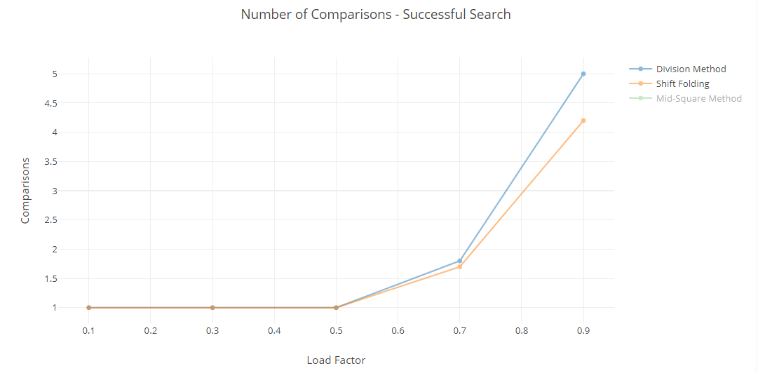
STATISTICS
INTRODUCTION • IMPLEMENTATION • STATISTICS • CONCLUSION

Slide 33
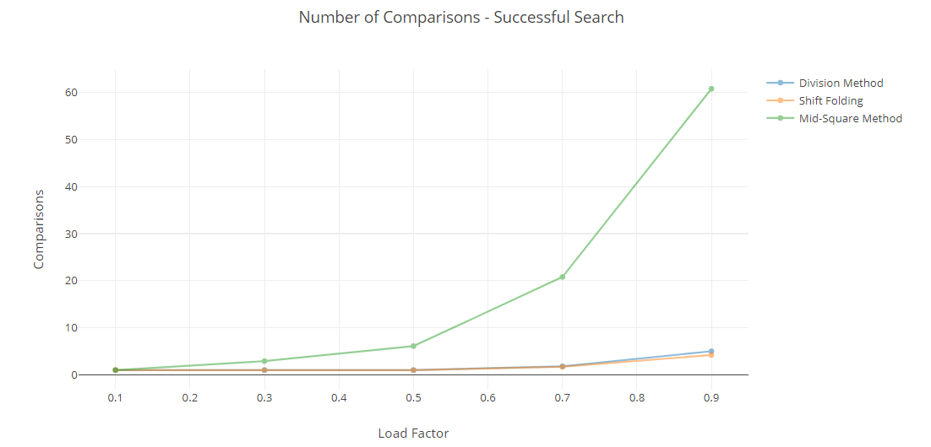
STATISTICS
INTRODUCTION • IMPLEMENTATION • STATISTICS • CONCLUSION

Slide 34
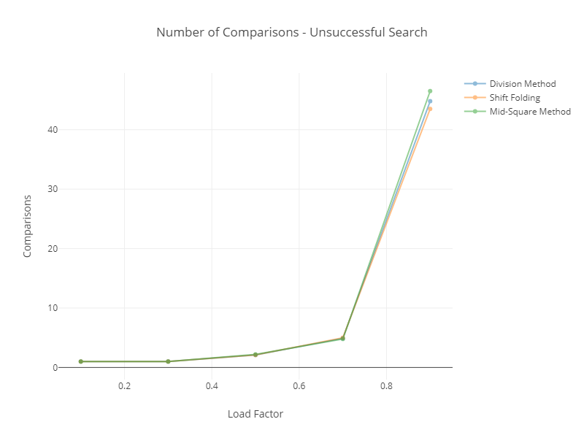
STATISTICS
INTRODUCTION • IMPLEMENTATION • STATISTICS • CONCLUSION

Slide 35
CONCLUSION

Slide 36

CONCLUSION
Since Linear Probing belong to Open Address Hashing, we can say that:
Worst Case: All the keys in one half of the table, another half is empty.
For an unsuccessful search the average number of probes is given by:
Best Case: All the keys in odd slots and even slots are empty;
The average number of probes for an unsuccessful search is constant when n is proportional to h
i.e. h=2n then the average is 0.5 (constant ) which is the load factor, so it has a constant complexity, namely O(1)
Image from lecture notes part 4 - searching
INTRODUCTION • IMPLEMENTATION • STATISTICS • CONCLUSION

